Slide 1
Illinois Report Card and School Financial Community Presentation
Month XX, 2022
Presenter’s Name, Title
Notes:
For the best results, use high resolution (300 ppi), square images or ones where the “action” is to the right of center.
Delete existing images and reset the slide layout if needed, rather than replacing an existing image.
Insert a new image
Click the picture icon in the center of an empty picture placeholder to open the Insert Picture dialog.
Navigate to the folder that contains the desired image, and
Double-click on the image.
If the placeholder becomes an oval, click on the Reset icon in the Slides group of the Home menu.
To zoom in on another portion of the image
Right click on the image and choose Crop from the context menu.
Zoom out the slide view so that the entire image, especially the white "handles" at the corners of the image, is visible in the main PPT window.
With the mouse, click and drag one of the handles to resize the image.
To shift the focal point of an image
Right click on the image and choose Crop from the context menu.
When the mouse pointer is a four-headed arrow, click and drag the image to a new position.
The image on this slide is only to assess final appearance and placement and must be replaced.

Slide 2
Instructions
This State Report Card and School Financial Community Presentation Template provides you with a meeting structure to directly communicate pertinent information to the audience.
We designed the presentation template to be inclusive and accessible to incorporate all the diversity in your district.
We ask you to pay special attention to the notes section within the presentation slide deck, where we included numerous considerations, questions, and reminders related to equity.

Slide 3
Objectives
Provide local background information
Summarize and explain elements of the School Report Card
Summarize and explain local and state financial information
Summarize and explain special circumstances specific to local district
Provide opportunities for additional information and feedback

Slide 4
Section 1: Opening
Notes:
Helpful hints:
Be sure to “Tell Your Local Story” when presenting the information.
Determine Your Target Audiences: Identify the primary groups of people who influence the success of your continuous improvement efforts, such as:
Teachers and principals - trusted messengers to parents and families
Parents and families - partners in their children’s education and in school improvement
Media - provide information to the broader community
School board members and other local elected officials - set policies and priorities and oversee personnel and budgets
Community partners and businesses - support school initiatives
Consider Accessibility: Consider the best way to deliver the information. For example:
Determine the appropriate reading levels of your audience.
Determine the appropriate language needs of your audience.
Determine the appropriate channels for outreach to a broad, diverse audience.
Determine the most appropriate dissemination methods.
Driving Questions to Inform Your Narrative: Write down answers to the questions below to see what connections and salient points arise.
What are the goals and values of our school or district?
What were the takeaways from our Illinois Quality Framework or other system needs assessment?
How have we invested or planned to invest our Evidence-Based Funding and, if applicable, Title I 1003(a) School Improvement Grant?
What do our new designation, changes in any achievement gaps, and growth in other indicators say about our progress?
What do my site-based expenditure data say? Do academic outcomes appear to be related to resource allocation?
What will our key audiences look for in our data? What questions will they have?
Identify Your Main Messages: Choose three takeaways you want your key audiences to know. Highlight:
One positive – An indicator or group of indicators that have improved in relation to your goals and values
One area of growth – Where you are focusing in the coming year and how your key audiences can engage
One investment – How you are investing Evidence-Based Funding to improve students’ opportunities and outcomes
Tools to Share Your Story: Decide what channels work best for communicating with your key audiences.
Draft talking points for senior leaders
Issue a press release
Share your highlights on social media
Host a media call to share your highlights with reporters and answer questions
Create a presentation for your board members
Host a town hall for families and community partners: highlight a program that aligns to your key messages
Publish a blog post and send the post home as a letter to families and staff
Section Objectives
Highlight celebrations and personalize any local recent successes. Tell your story!
Articulate the philosophy of the current school board and district leadership.
Provide any necessary local background information.
Resource link:
Illinois Report Card “How to Tell Your Story” 2022: https://www.isbe.net/Documents/2022ReportCard-TellYourStory.pdf
Equity Journey Continuum Resources: https://www.isbe.net/equity

Slide 5
Celebrations and Personalized Successes
5
Notes:
Slide(s) should provide detailed information such as:
Any local accomplishments, student academic successes, student athletic successes, recent financial savings and improvements, recent facility improvements, technology innovations and improvements, local community partnership successes, and any other pertinent information the school community should celebrate.
Helpful hints:
Be sure to truly personalize this type of information as it builds positive relationships and trust between the school and the community.
Questions to consider addressing:
Is the information that is being presented considered “important” to the present audience?
Are there any successes or celebrations related to addressing or overcoming the impacts of COVID-19 that can be incorporated?
Are there any successes or celebrations related to your district or school strategic plan or goals that can be incorporated?

Slide 6
Philosophy of School Board and Leadership
6
Notes:
Slide(s) should provide detailed information, such as:
Any known local and public philosophy from the school board and/or administration.
Helpful hints:
This information could include the district’s mission/vision as well as any known public positions on fiscal management practices, tax rate goals, fund balance managing, personnel decisions, etc.
Consider pointing out that the district website has a location for board of education information (e.g., agendas, minutes).
Consider pointing out that the district website has a location for the district’s strategic plan, if applicable.
Consider discussing how issues of equity are being addressed.
Questions to consider addressing:
Has the board or administration publicly stated any district mission, vision, or philosophy that should be reiterated with this audience?
How can the impacts of COVID-19 be incorporated?
5

Slide 7
Local Background Information
Notes:
Slide(s) should provide detailed information, such as:
Any local recent happenings in the district and community that are important to the context of this presentation. Examples include, but are not limited to, the following:
Teacher strikes
Negotiations
New housing or business developments
Business bankruptcies
Current or new TIF districts
New board member elections
Helpful hints:
Be sure to capture any significant happenings in the school community that may be on the minds of audience members.
6

Slide 8
Section 2: School Report Cards
Notes:
Helpful hints:
Be sure to “Tell Your Local Story” when presenting the information. Every district and school has a “reason why” for all aspects of the report card and financial information. Be sure this information is clearly expressed so that the audience fully understands the local context of the material.
Resource links:
Illinois Report Card: https://www.illinoisreportcard.com/
Illinois Report Card Glossary of Terms: https://www.isbe.net/Documents/2021-Report-Card-Glossary-Terms.pdf
Section Objectives
Define common terms in the state report card.
Describe student demographics and subgroup populations.
Describe teacher demographics.
Explain different tier designations of performance.
Detail significant historical trends in state designations.
Summarize academic progress and student achievement.
Summarize student subgroups and achievement gaps.
Summarize student graduation rates and historical trends data (for high schools).
Detail performance comparisons between schools within the district.
Detail performance comparisons between neighboring and state school districts.
7

Slide 9
Common terms in the Illinois Report Card
Demographics
Tier Designations
Academic Progress
Subgroups
Achievement Gap
Graduation Rate
Notes:
Slide(s) should provide detailed information, such as:
A summary of what the Illinois Report Card presents, when it’s available, and definitions for terms that the audience will need to know to fully understand the information in the report card. You also may wish to define these terms as you go through the presentation, and now may be the time to inform the audience that you will be doing that as you move along. A few terms are provided as an example.
Helpful hints:
Be sure to define and articulate any acronyms used for the first time.
Do not assume the audience knows any abbreviations or acronyms.
Simplify the message so that everyone in the audience can clearly understand.
Questions to consider addressing:
Where can I find the school report card?
Do all districts and schools have a report card?
Resource links:
Illinois Report Card: https://www.illinoisreportcard.com/
Illinois Report Card Glossary of Terms: https://www.isbe.net/Documents/2021-Report-Card-Glossary-Terms.pdf

Slide 10
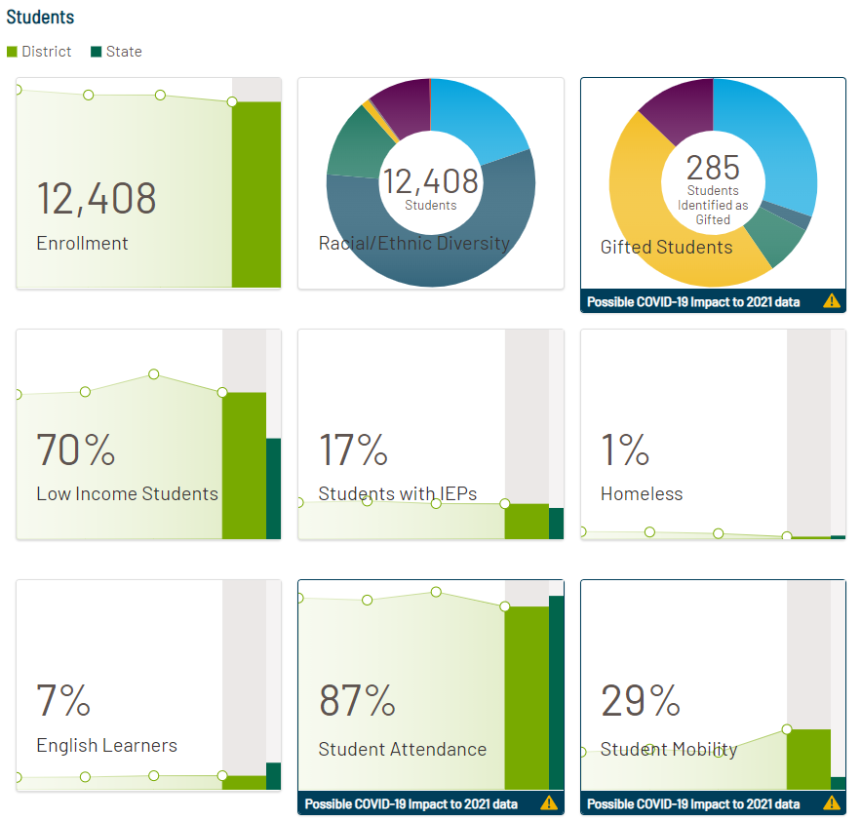
Student Demographics
Notes:
Slide contains a sample graphic. Please update with graphic specific to your district.
Slide(s) should provide detailed information, such as:
Student enrollment, racial/ethnic diversity, low-income percentages, IEP percentages, homeless percentages, EL percentages, student attendance and mobility rates, chronic absenteeism and dropout rates, and chronically truant students. Helpful hints:
Think about the trends or changes that are important for the audience to learn.
“Student Attendance Rate is a weighted measure of the number of days a student is present relative to the total number of potential attendance days” (ISBE, 2021).
“Student Enrollment is the total student enrollment in the school and district as of October 1 of the current school year. District-level enrollment includes students attending a school in the district and students placed in private schools by the district and funded by the district. This number does not include: 1. Students given vouchers to attend private schools. 2. Students placed by their parents in private schools whose tuition is paid for by their parents, but who receive special education services from their home district. 3. Students who do not attend a public school for at least 50 percent of the day” (ISBE, 2021).
“A school’s student mobility rate is the percentage of students who experienced at least one transfer in or out of the school between the first day of October and the last school day of the year, not including graduates” (Illinois Report Card, 2022).
Consider clearly portraying student subgroup data for the audience.
Consider illustrating how some students may be identified in multiple subgroup populations, such as low-income category and in EL or IEP category, (e.g., a VENN diagram). https://en.wikipedia.org/wiki/Venn_diagram
Questions to consider addressing:
Have our student enrollment or graduation rates changed significantly in recent years, and, if so, why?
Are our student demographics changing significantly, and what does that mean for our school?
How can the impacts of and recovery from COVID-19 be incorporated?
Resource links:
Illinois Report Card: https://www.illinoisreportcard.com/
Illinois Report Card Glossary of Terms: https://www.isbe.net/Documents/2021-Report-Card-Glossary-Terms.pdf

Slide 11
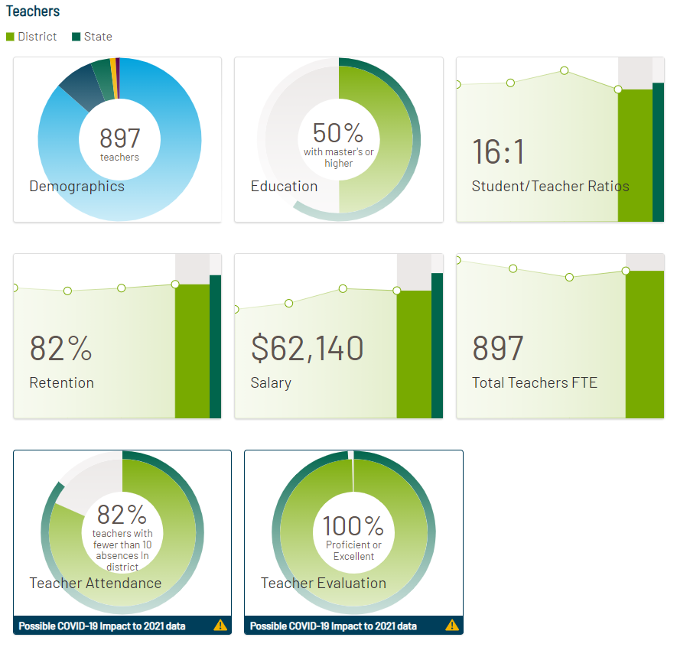
Teacher Demographics
Notes:
Slide contains a sample graphic. Please update with graphic specific to your district.
Slide(s) should provide detailed information, such as:
Teachers’ education, pupil/teacher ratios, retention, salary, total teachers FTE, teacher attendance, and teacher evaluation. Helpful hints:
Think about the trends or changes that are important for the audience to learn.
Be prepared to clarify the teacher attendance calculation and the pupil/teacher ratio, as those may not be fully understood.
Consider portraying the “years of experience in district” for the teaching staff.
Consider addressing how issues of equity are being addressed.
Questions to consider addressing:
What does FTE mean?
What does retention mean?
How is teacher attendance calculated?
What is a teacher evaluation rating?
Have our teacher demographics changed significantly, and what does that mean for our school?
How can the impacts of and recovery from COVID-19 be incorporated?
Resource links:
Illinois Report Card: https://www.illinoisreportcard.com/
Illinois Report Card Glossary of Terms: https://www.isbe.net/Documents/2021-Report-Card-Glossary-Terms.pdf

Slide 12
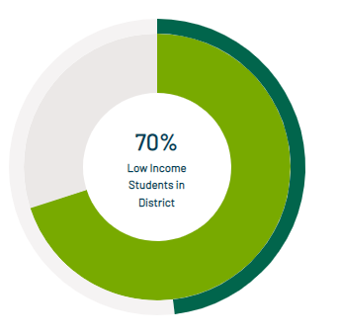
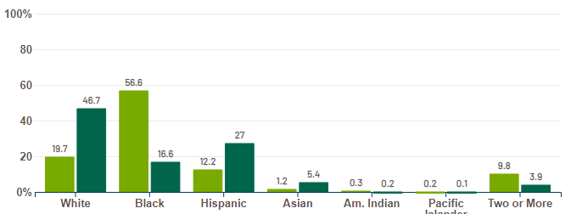
Student Demographics (Continued)
Notes:
Slide contains a sample graphic. Please update with graphic specific to your district.
Slide(s) should provide detailed information, such as:
Student enrollment, racial/ethnic diversity, low-income percentages, IEP percentages, homeless percentages, EL percentages, student attendance and mobility rates, chronic absenteeism and dropout rates, and chronically truant students. Helpful hints:
Think about the trends or changes that are important for the audience to learn.
“Student Attendance Rate is a weighted measure of the number of days a student is present relative to the total number of potential attendance days” (ISBE, 2021).
“Student Enrollment is the total student enrollment in the school and district as of October 1 of the current school year. District-level enrollment includes students attending a school in the district and students placed in private schools by the district and funded by the district. This number does not include: 1. Students given vouchers to attend private schools. 2. Students placed by their parents in private schools whose tuition is paid for by their parents, but who receive special education services from their home district. 3. Students who do not attend a public school for at least 50 percent of the day” (ISBE, 2021).
“A school’s student mobility rate is the percentage of students who experienced at least one transfer in or out of the school between the first day of October and the last school day of the year, not including graduates” (Illinois Report Card, 2022).
Consider clearly portraying student subgroup data for the audience.
Consider illustrating how some students may be identified in multiple subgroup populations, such as low-income category and in EL or IEP category, (e.g., a VENN diagram). https://en.wikipedia.org/wiki/Venn_diagram
Questions to consider addressing:
Have our student enrollment or graduation rates changed significantly in recent years, and, if so, why?
Are our student demographics changing significantly, and what does that mean for our school?
How can the impacts of COVID-19 be incorporated?
Resource links:
Illinois Report Card: https://www.illinoisreportcard.com/
Illinois Report Card Glossary of Terms: https://www.isbe.net/Documents/2021-Report-Card-Glossary-Terms.pdf

Slide 13
Tier Designations
Exemplary – Schools performing in the top 10 percent of schools statewide with no underperforming student groups.
Commendable – A school that has no underperforming student groups, a graduation rate greater than 67%, and whose performance is not in the top 10 percent of schools statewide.
Targeted – A school in which one or more student groups is performing at or below the level of the “all students” group in the lowest performing 5 percent of schools.
Comprehensive – A school that is in the lowest-performing 5 percent of schools in Illinois and any high school with a graduation rate of 67% or less.
Notes:
Slide(s) should provide detailed information, such as:
A brief explanation of the tier designation for the district and schools, and how these designations were determined by the Illinois State Board of Education.
NOTE: The requirement to issue summative designations was waived in 2020 and 2021 due to COVID-19. The U.S. Department of Education is requiring that new annual summative designations be issued again in 2022. The updated plan for issuing summative designations can be found here: https://www.isbe.net/Documents/2022-ESSA-Amendment-Executive-Summary.pdf
Questions to consider addressing:
If appropriate, why specifically has the designation improved or declined from last year?
What specifically made us improve/decline? (If subgroup-related, clarify and provide statistics.)
What funding implications are associated with this change?
What are the criteria for determining the designation from ISBE?
How many schools in the state (or local area) are in the same category as our district or school?
How can the impacts of COVID-19 be incorporated?
Resource links:
Illinois Report Card: https://www.illinoisreportcard.com/
Illinois Report Card Glossary of Terms: https://www.isbe.net/Documents/2021-Report-Card-Glossary-Terms.pdf
ISBE Summative Designations: https://www.isbe.net/Documents/Illinois_ESSA_State_Plan_one-pager.pdf#search=essa%20designations

Slide 14
Historical Trend of Designations
Notes:
Slide(s) should provide detailed information, such as:
A historical trend of district and school designations from ISBE to show performance of the district and school over a select period of time.
NOTE: The requirement to issue summative designations was waived in 2020 and 2021 due to COVID-19. The U.S. Department of Education is requiring that new annual summative designations be issued again in 2022. The updated plan for issuing summative designations can be found here: https://www.isbe.net/Documents/2022-ESSA-Amendment-Executive-Summary.pdf
Helpful hints:
Think about whether there are any academic or social-emotional initiatives that impact these tier designation trends.
Questions to consider addressing:
If appropriate, why specifically has the designation improved or declined from last year?
What specifically made us improve/decline?
What funding implications are associated with this change?
How many schools in the state (or local area) are in the same category as our district or school?
How can the impacts of COVID-19 be incorporated?
Resource links:
Illinois Report Card: https://www.illinoisreportcard.com/
Illinois Report Card Glossary of Terms: https://www.isbe.net/Documents/2021-Report-Card-Glossary-Terms.pdf
ISBE Summative Designations: https://www.isbe.net/summative

Slide 15
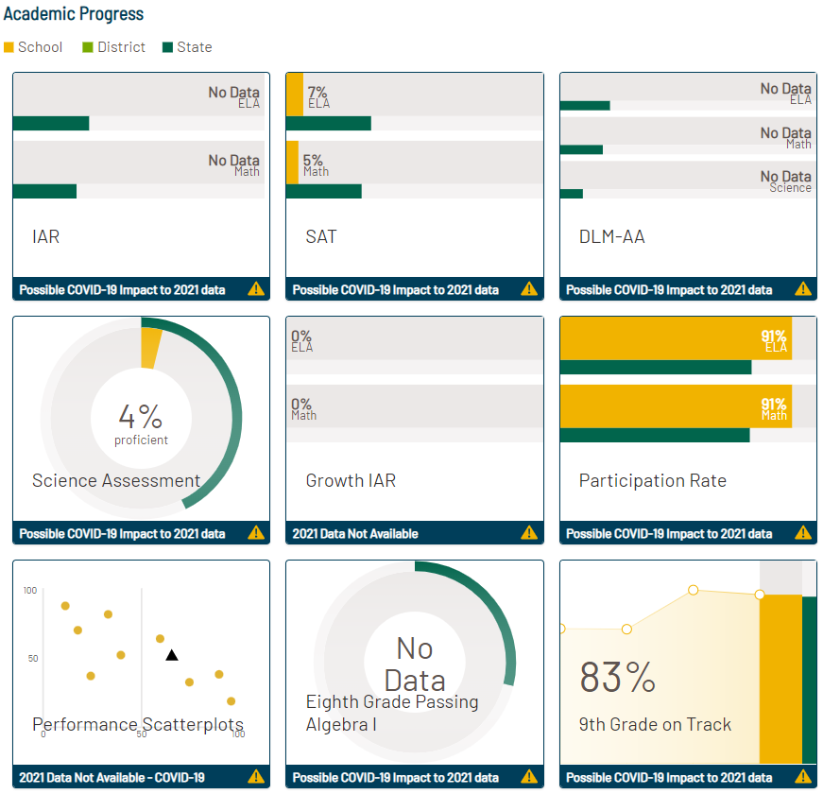
Academic Progress
Notes:
Slide contains a sample graphic. Please update with graphic specific to your district.
Slide(s) should provide detailed information, such as:
A summary of the report card student achievement data for the district and schools.
Helpful hints:
Briefly demonstrate how the school district (as a whole) is performing academically. This is part of the overall description of the district and should not be omitted.
Consider mentioning the district’s improvement plans when talking about “reasons” for any improving/declining performance.
Consider addressing how issues of equity are being addressed.
Questions to consider addressing:
How does our district’s performance compare with last year’s report card?
How does our district’s performance compare with the averages in the state?
How does our district’s performance compare with other local districts?
What are the primary reasons for us improving or declining?
How can the impacts of COVID-19 be incorporated?
Resource links:
Illinois Report Card: https://www.illinoisreportcard.com/
Illinois Report Card Glossary of Terms: https://www.isbe.net/Documents/2021-Report-Card-Glossary-Terms.pdf
ISBE Summative Designations: https://www.isbe.net/summative

Slide 16
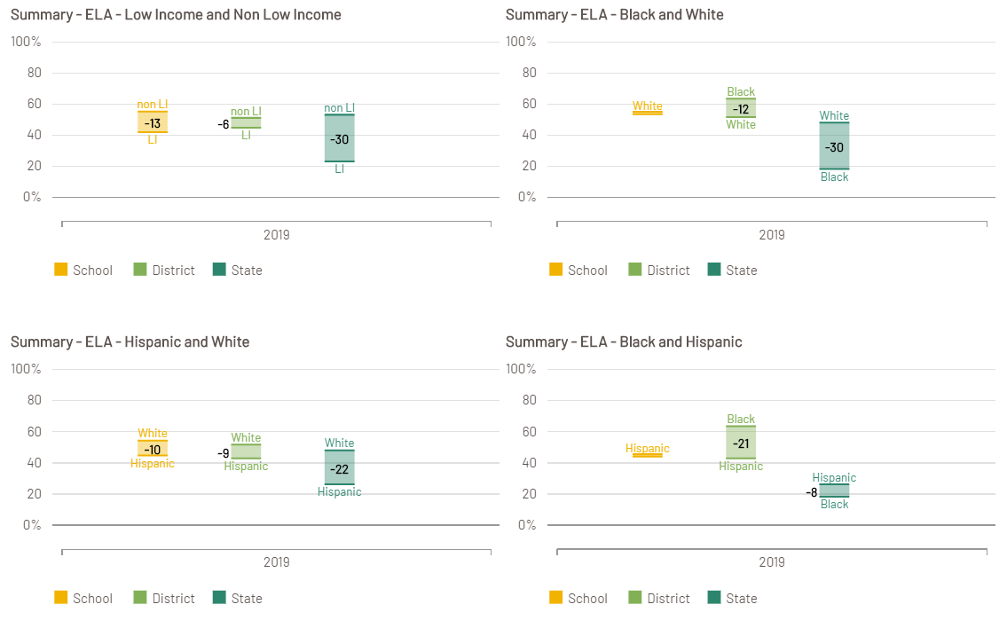
Student Subgroups and Achievement Gaps
Notes:
Slide contains a sample graphic. Please update with graphic specific to your district.
Slide(s) should provide detailed information, such as:
A summary of the report card achievement gap data regarding student subgroup performance, and how their performance varies from the “all” group, if it does. Acknowledge the importance of these differences and that they are a focus of school improvement efforts (if they are).
NOTE: Some data might not be available due to COVID-19.
Helpful hints:
Explain how student subgroups are defined, by ISBE standards.
Define low-income standards.
Consider discussing how issues of equity are being addressed.
Questions to consider addressing:
How is a student subgroup defined?
What does it mean to be considered low-income?
Why is it important to monitor the progress of subgroup students?
What is our district or school doing to try to improve the performance of our student subgroups?
How can the impacts of COVID-19 be incorporated?
Resource links:
Illinois Report Card: https://www.illinoisreportcard.com/
Illinois Report Card Glossary of Terms: https://www.isbe.net/Documents/2021-Report-Card-Glossary-Terms.pdf
ISBE Summative Designations: https://www.isbe.net/summative

Slide 17
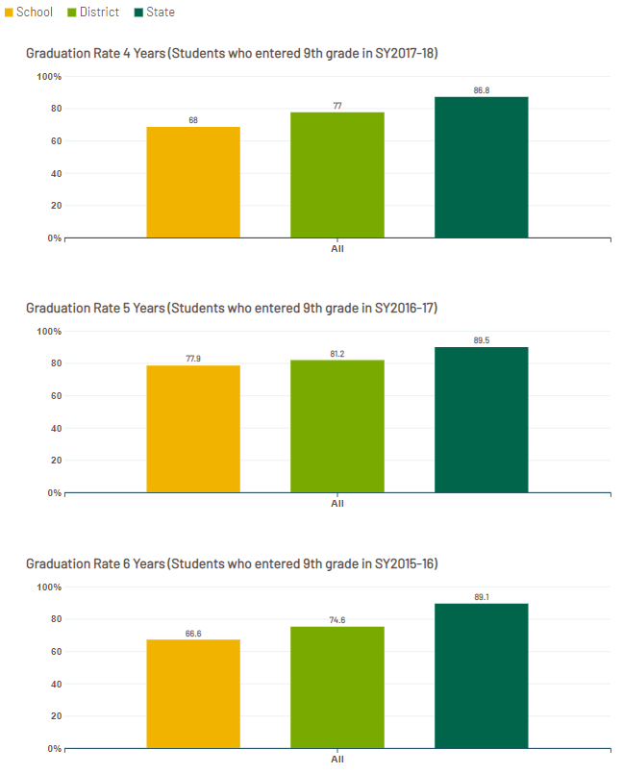
Student Graduation Rates
Notes:
Slide contains a sample graphic. Please update with graphic specific to your district.
Slide(s) should provide detailed information, such as:
For high schools, a comparison of the current graduation rate for students as well as any trend data to show performance over a period of time.
Helpful hints:
The graduation rate is calculated based using federal guidance. For more information, go to https://www2.ed.gov/policy/elsec/leg/essa/essagradrateguidance.pdf.
Consider discussing how issues of equity are being addressed.
Questions to consider addressing:
Why specifically are our students graduating at a higher/lower rate than previous years?
What is the difference between the 4-, 5-, and 6-year rates?
What are the primary three reasons why students are not graduating high school in our community?
How can the impacts of COVID-19 be incorporated?
Resource links:
Illinois High School Graduation Requirements: https://www.isbe.net/Documents/grad_require.pdf
Illinois Report Card: https://www.illinoisreportcard.com/
Illinois Report Card Glossary of Terms: https://www.isbe.net/Documents/2021-Report-Card-Glossary-Terms.pdf

Slide 18
School Comparisons
Notes:
Slide(s) should provide detailed information, such as:
A summary comparison between schools within the district may be necessary depending on the size of the district.
Helpful hints:
Summarize any major differences between the schools if necessary. Emphasize that certain programs may be located in certain schools, therefore changing the dynamics of the averages.
Consider emphasizing that principals will present more detailed information about their schools in their own forums with local school community members.
Questions to consider addressing:
Why does one school outperform another school in the same district?
Why do the demographics of one school look so different from another when we are in the same school community?
How can the impacts of COVID-19 be incorporated?
Resource links:
Illinois High School Graduation Requirements: https://www.isbe.net/Documents/grad_require.pdf
Illinois Report Card: https://www.illinoisreportcard.com/
Illinois Report Card Glossary of Terms: https://www.isbe.net/Documents/2021-Report-Card-Glossary-Terms.pdf

Slide 19
District Comparisons
Notes:
Slide(s) should provide detailed information, such as:
A summary comparison with neighboring school districts, if expected in your setting, and acknowledging that districts are unique and may have significant demographic and financial differences, making them difficult to compare.
Helpful hints:
Summarize any major differences between the local districts if necessary.
Clarify that demographics and finances in neighboring districts can be drastically different, depending on enrollment, district type, tax base, board philosophy, etc.
Questions to consider addressing:
Why is our district funding so different than our neighboring district (especially because we may seem so similar)?
Why are we performing so differently than our neighboring district (especially because we may seem so similar)?
How can the impacts of COVID-19 be incorporated?
Resource links:
Illinois High School Graduation Requirements: https://www.isbe.net/Documents/grad_require.pdf
Illinois Report Card: https://www.illinoisreportcard.com/
Illinois Report Card Glossary of Terms: https://www.isbe.net/Documents/2021-Report-Card-Glossary-Terms.pdf

Slide 20
Section 3: Finances
Notes:
Helpful hints:
Be sure to “Tell Your Local Story” when presenting the information. Every district and school has a “reason why” for all aspects of the report card and financial information. Be sure this information is clearly expressed so that the audience fully understands the local context of the material.
Resource links:
Illinois Report Card Glossary of Terms: https://www.isbe.net/Documents/2021-Report-Card-Glossary-Terms.pdf
Understanding School Finance: 12 Questions and Answers: https://www.iasb.com/IASB/media/General/understanding-school-finance.pdf
Section Objectives
Define common financial terms.
Describe annual budget and tax levy timeline and process.
Provide the financial profile rating of the district and historical trends.
Identify district and school adequacy targets and financial capacity levels.
Identify different operating funds, requirements, and limitations of use.
Provide district fund balances and recent trends of significance.
Summarize revenue sources, amounts, and recent significant trends.
Discuss the influx of funds from the Elementary and Secondary School Emergency Relief (ESSER) Fund.
Summarize district and school expenditures, amounts, and significant trends.
Describe typical drivers of school spending and variations.
Describe dimensions of resource equity.

Slide 21
Common Financial Terms
Tax Levy
Financial Profile Rating
Adequacy Target
Financial Capacity
Operating Funds
Revenue
ESSER
Expenditures
Resource Equity
Notes:
Slide(s) should provide detailed information, such as:
Definitions of common financial terms, such as revenue, expenditure fund balance, operating funds, budget, adequacy target, evidence-based funding, etc. You also may wish to define these terms as you go through the presentation, and now may be the place to inform the audience that you will be doing that as you move along. A few terms are provided as an example.
Helpful hints:
Be sure to articulate any acronyms used for the first time. Do not assume the audience knows any abbreviations or acronyms.
Simplify the message so that everyone in the audience can clearly understand.
Questions to consider addressing:
Where can I find financial information about our school district?
What other financial information is available on our district website?
Resource links:
Illinois Report Card: https://www.illinoisreportcard.com/
Illinois Report Card Glossary of Terms: https://www.isbe.net/Documents/2021-Report-Card-Glossary-Terms.pdf
Understanding School Finance: 12 Questions and Answers: https://www.iasb.com/IASB/media/General/understanding-school-finance.pdf

Slide 22
Annual Budget and Tax Levy Timeline
Notes:
Slide(s) should provide detailed information, such as:
The main timeline requirements for the board of education to adopt a budget, post it publicly, and file it with the state. This also should include the main timeline requirements for the board of education to host a truth-in-taxation hearing, adopt a tax levy, and file it with the county.
Helpful hints:
“Illinois law requires every board of education to budget its income and expenses each year and to make the budget available for public inspection before final adoption. The annual budget serves three major purposes: 1. The budget represents a plan for receiving and expending money. It tells the school board, its employees, and the public how much the school district can spend during the year and for what purposes. 2. The budget provides information necessary to determine the amount of school taxes that must be levied on real property, and how much the district expects to receive from state and federal governments. 3. The budget also satisfies a minimum level of financial and program information for local, state, and federal governments; meets requirements imposed by Illinois law; and provides both spending and taxing authority.” (IASB, 2022)
“Some of what goes into the school district budget is determined by the board of education, based on the advice of its professional staff and local citizens. More and more budget decisions, however, are forced on the board by factors beyond its control. Each year, the administrative staff gathers information from a variety of sources and presents the school board with a proposed budget. After carefully reviewing the budget, the board gives tentative approval and puts it on file for public inspection. The board gives final approval of the budget only after a public hearing. The timeline for developing a tentative budget to its adoption varies from district to district. The budget must be adopted by September 30, after which it must be filed with the county clerk within 30 days. Numerous factors are at work throughout this seemingly simple process. Some of these factors affect school income; some affect expenses. Taken together, these factors represent the financial cards dealt to each Illinois school board….” (IASB, 2022)
Consider sharing this information in a flowchart or timeline graphic. Present this information concisely, and point audience members who wish for more information to the district website Frequently Asked Questions document.
Questions to consider addressing:
How are budgeting decisions made, and by whom?
Where can I find a copy of the district’s budget?
What is the tax levy, and how does it affect me?
What does the budgeting process look like?
How can the impacts of COVID-19 be incorporated?
Resource links:
Illinois Report Card: https://www.illinoisreportcard.com/
Illinois Report Card Glossary of Terms: https://www.isbe.net/Documents/2021-Report-Card-Glossary-Terms.pdf
Understanding School Finance: 12 Questions and Answers: https://www.iasb.com/IASB/media/General/understanding-school-finance.pdf

Slide 23
Financial Profile Rating
Notes:
Slide contains a sample graphic. Please update with graphic specific to your district.
Slide(s) should provide detailed information, such as:
A brief summary of the financial profile rating from the Illinois State Board of Education for the current year. Trend data also may be provided for historical perspective.
Helpful hints:
Provide a snapshot of the ratings for all districts in the state for a quick comparison to other districts. Consider adding the Moody’s bond rating or any other rating that is pertinent to the district.
Questions to consider addressing:
How does our district’s financial rating compare with that of other school districts in Illinois?
How can we improve our financial rating if it is low?
If our financial rating is good, why aren’t we hiring more teachers and staff to better support our students?
How can the impacts of COVID-19 be incorporated?
Resource links:
Illinois Report Card: https://www.illinoisreportcard.com/
Illinois Report Card Glossary of Terms: https://www.isbe.net/Documents/2021-Report-Card-Glossary-Terms.pdf
ISBE School District Financial Profile: https://www.isbe.net/Pages/School-District-Financial-Profile.aspx
Understanding School Finance: 12 Questions and Answers: https://www.iasb.com/IASB/media/General/understanding-school-finance.pdf

Slide 24
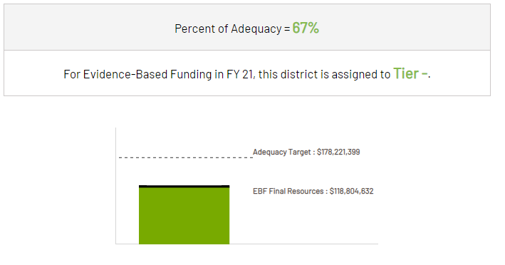
Adequacy Target and Financial Capacity
Notes:
Slide contains a sample graphic. Please update with graphic specific to your district.
Slide(s) should provide detailed information, such as:
The district’s Evidence-Based Funding financial information and Adequacy Target rates as shown on the report card.
Helpful hints:
“Each district's Adequacy Target is the calculated cost to educate students within the district based on the cost factors outlined in EBF. Please refer to ISBE's resource materials for the list of cost factors and the steps EBF requires to determine a district's Adequacy Target. Each district's Adequacy Target is calculated by ISBE and updated annually. Please note that the Adequacy Target is not equal to funding but is what is determined to be the cost of adequate education in each district.” (ISBE, 2022)
Consider relating “adequacy” to the school experience – the school experience may change if this percentage of spending increases or decreases.
Questions to consider addressing:
Why is the Adequacy Target so important?
What does it mean if our financial capacity to meet expectations is really low or really high?
Where can I learn more about this financial information?
Do we receive additional funding for being in a certain tier?
Resource links:
Illinois Report Card: https://www.illinoisreportcard.com/
Illinois Report Card Glossary of Terms: https://www.isbe.net/Documents/2021-Report-Card-Glossary-Terms.pdf
Understanding School Finance: 12 Questions and Answers: https://www.iasb.com/IASB/media/General/understanding-school-finance.pdf

Slide 25
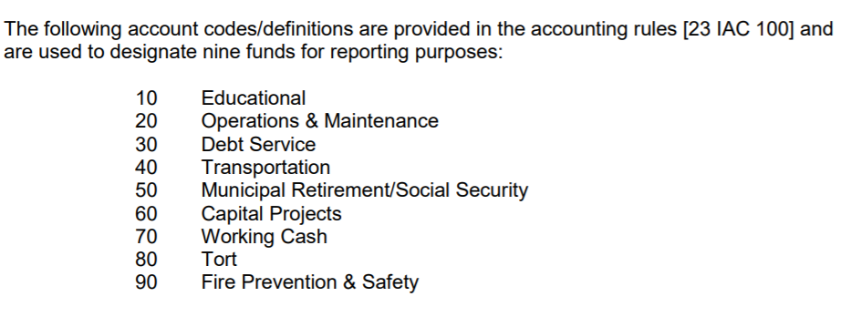
Operating Funds
Notes:
Slide(s) should provide detailed information, such as:
A brief synopsis of the different operating funds of a school district and the limitations on usage of each fund.
Helpful hints:
Be sure to point out that the tax levy typically limits the amount of taxes you can levy for each fund depending on the type of district. Emphasize that this is similar to having multiple checking accounts, with certain amounts of revenue coming into each, and that they can only be utilized for very specific purposes.
Consider discussing the blending and braiding of funds.
Consider addressing how issues of equity are being addressed. What are examples of this?
Questions to consider addressing:
Why are we improving our facilities when we cannot afford more teachers?
Why are we hiring more teachers when our transportation buses are so old?
How can the impacts of COVID-19 be incorporated?
Resource links:
Mechanics of a School District Budget: https://www.isbe.net/Documents/mechanics.pdf
Understanding School Finance: 12 Questions and Answers: https://www.iasb.com/IASB/media/General/understanding-school-finance.pdf

Slide 26
Fund Balances
Notes:
Slide(s) should provide detailed information, such as:
A summary of current fund balances of the school district and possibly recent trend data to show any improvements or concerns.
Helpful hints:
Clarify that ISBE rates the district on its ability to maintain a certain amount of financial reserves (days of cash on hand).
Emphasize that the state has historically been behind in certain payments and reimbursements, supporting the need for more reserves.
Consider commenting on the district’s board policy on maintaining financial reserves or certain fund balances.
Consider defining what “reserves” mean. Reiterate that reserves are not maintained to handle day-to-day operations. Reserves are maintained to pay salaries and services of district staff when the state is significantly delayed in providing district revenue. Reserves also help with unexpected emergency needs.
Consider explaining the concept of 180 days’ cash on hand as emphasized by ISBE.
Questions to consider addressing:
Why do we have so much money in the bank while we maintain high class sizes?
What is our plan to improve our financial condition?
How are we planning to use these funds to improve students’ educational experiences?
How can the impacts of COVID-19 be incorporated?
Resource links:
Illinois Report Card: https://www.illinoisreportcard.com/
Illinois Report Card Glossary of Terms: https://www.isbe.net/Documents/2021-Report-Card-Glossary-Terms.pdf
Understanding School Finance: 12 Questions and Answers: https://www.iasb.com/IASB/media/General/understanding-school-finance.pdf

Slide 27
Revenue
Notes:
Slide contains a sample graphic. Please update with graphic specific to your district.
Slide(s) should provide detailed information, such as:
A summary of all revenue for the district, including tax levy, local revenue, local grants, local foundation revenue, state grants, federal grants, any reimbursements, etc.
Helpful hints:
“General State Aid was the primary state grant to school districts in effect in Illinois for fiscal years 1999–2017. It was repealed with the passage of Public Act 100-0582. This grant program and four other state grants were combined to form the new primary state grant known as Evidence-Based Funding. The Report Card displays some data from FY 2017, and revenues from that period may reflect General State Aid receipts.” (ISBE, 2019)
State any indication of new funds since past years.
Questions to consider addressing:
Where does our school district’s money come from?
How are federal and state revenue amounts determined?
How does the state help fund our school district?
Do federal funds help our school district?
What grants does our school district receive?
How can the impacts of COVID-19 be incorporated?
Resource links:
Illinois Report Card: https://www.illinoisreportcard.com/
Illinois Report Card Glossary of Terms: https://www.isbe.net/Documents/2021-Report-Card-Glossary-Terms.pdf
Understanding School Finance: 12 Questions and Answers: https://www.iasb.com/IASB/media/General/understanding-school-finance.pdf

Slide 28
Revenue (Continued)
Notes:
Slide(s) should provide detailed information, such as:
A summary of all revenue for the district including tax levy, local revenue, local grants, local foundation revenue, state grants, federal grants, any reimbursements, etc.
Helpful hints:
“General State Aid was the primary state grant to school districts in effect in Illinois for fiscal years 1999–2017. It was repealed with the passage of Public Act 100-0582. This grant program and four other state grants were combined to form the new primary state grant known as Evidence-Based Funding. The Report Card displays some data from FY 2017, and revenues from that period may reflect General State Aid receipts.” (ISBE, 2019)
Questions to consider addressing:
Where does our school district’s money come from?
How are federal and state revenue amounts determined?
How does the state help fund our school district?
Do federal funds help our school district?
What grants does our school district receive?
How can the impacts of COVID-19 be incorporated?
Resource links:
Illinois Report Card: https://www.illinoisreportcard.com/
Illinois Report Card Glossary of Terms: https://www.isbe.net/Documents/2021-Report-Card-Glossary-Terms.pdf
Understanding School Finance: 12 Questions and Answers: https://www.iasb.com/IASB/media/General/understanding-school-finance.pdf

Slide 29
Elementary and Secondary School Emergency Relief (ESSER) Funding
Notes:
Illinois’ plan for using the ESSER funds was approved by the U.S. Department of Education on August 27, 2021.
Slide(s) should provide detailed information, such as:
How much the district received in ESSER funds.
How ESSER funds were used locally.
How the district will evaluate the local impact of those funds.
Helpful hints:
Consider explaining how decisions were made regarding the use of ESSER funds.
Consider addressing how issues of equity are being addressed. What are examples of this?
Consider addressing how the district is involving key individuals to determine the most appropriate needs.
Resource links:
ISBE ARP ESSER plans: https://www.isbe.net/Pages/ARP-ESSER-Plans.aspx
U.S. Department of Education approval of Illinois’ ESSER plan: https://www.ed.gov/news/press-releases/us-department-education-approves-illinois-plan-use-american-rescue-plan-funds-support-k-12-schools-and-students-distributes-remaining-16-billion-state

Slide 30
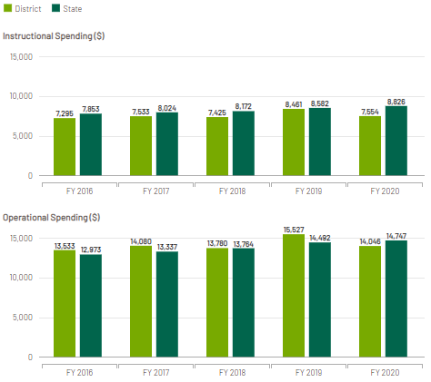
Expenditures
Notes:
Slide contains a sample graphic. Please update with graphic specific to your district.
Slide(s) should provide detailed information, such as:
A summary of basic district expenditures, including salary and benefits, transportation costs, facility improvements, shared service costs, cooperative agreement costs, special education placement costs, outsourcing service costs, etc.
Helpful hints:
“Average spending per student in this district, based on financial data collected in the audited Annual Financial Report. ISBE calculates instructional spending and operational spending and divides both by the district’s student count. Instructional Spending Per Student includes only the activities directly dealing with the teaching of students or the interaction between teachers and students. Operational Spending Per Student includes nearly all costs for overall operations in this school’s district, including Instructional Spending.” (Illinois Report Card, 2022).
Consider comparing the rate of revenue coming into the district and the rate of expenditures going out of the district.
Consider discussing how issues of equity are being addressed.
Questions to consider addressing:
Why is our district spending more money than in previous years?
Why are we spending significantly more or less than the state average?
What is the primary difference between education expenditures per pupil and operational expenditures per pupil?
How can the impacts of COVID-19 be incorporated?
Resource links:
Illinois Report Card: https://www.illinoisreportcard.com/
Illinois Report Card Glossary of Terms: https://www.isbe.net/Documents/2021-Report-Card-Glossary-Terms.pdf
Understanding School Finance: 12 Questions and Answers: https://www.iasb.com/IASB/media/General/understanding-school-finance.pdf

Slide 31
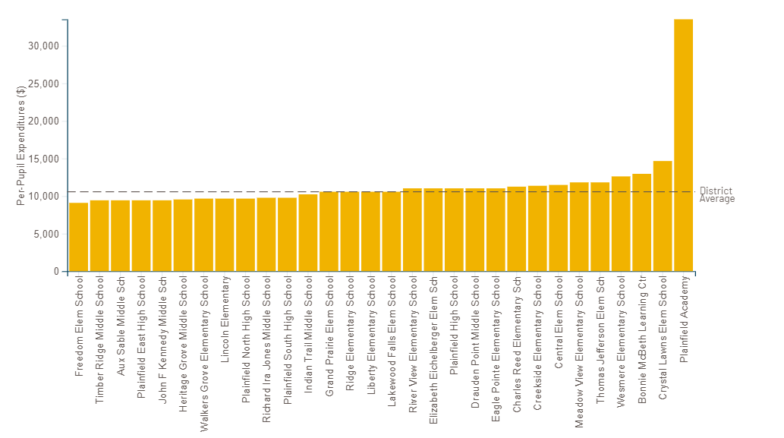
Expenditures (Continued)
Notes:
Slide contains a sample graphic. Please update with graphic specific to your district.
Slide(s) should provide detailed information, such as:
A breakdown of the per-pupil expenditures for each school building in the district.
Helpful hints:
It is important here to explain why the figures may vary between schools and that cost is not a direct correlation to student achievement results.
Questions to consider addressing:
Why do some schools spend more money than other schools?
Why don’t all the schools require the same costs to operate?
How can the impacts of COVID-19 be incorporated?
Consider discussing how issues of equity are being addressed.
Resource links:
Illinois Report Card: https://www.illinoisreportcard.com/
Illinois Report Card Glossary of Terms: https://www.isbe.net/Documents/2021-Report-Card-Glossary-Terms.pdf
Understanding School Finance: 12 Questions and Answers: https://www.iasb.com/IASB/media/General/understanding-school-finance.pdf

Slide 32
Expenditures (Continued)
A state and its local education agencies (LEAs) must annually report per-pupil expenditures of federal, state, and local funds on state education agency and LEA report cards, disaggregated by source of funds.
Per-pupil expenditures must include actual personnel and nonpersonnel expenditures.
A state and its LEAs must report per-pupil expenditures for the LEA as a whole and for each school served by the LEA for the preceding fiscal year.
ESEA §1111(h)(1)(C)(x), (h)(2)(C)
Notes:
Slide(s) should provide detailed information, such as:
A breakdown of the difference between per-pupil expenditures for each school building.
Helpful hints:
Consider explaining why the changes were made for the public reporting transparency.
Questions to consider addressing:
Why do some schools spend more money than other schools?
Why don’t all the schools require the same costs to operate?
How can the impacts of COVID-19 be incorporated?
Consider discussing how issues of equity are being addressed.
Resource links:
Illinois Report Card: https://www.illinoisreportcard.com/
Illinois Report Card Glossary of Terms: https://www.isbe.net/Documents/2021-Report-Card-Glossary-Terms.pdf
Understanding School Finance: 12 Questions and Answers: https://www.iasb.com/IASB/media/General/understanding-school-finance.pdf

Slide 33
Typical Drivers of School Spending Variation
Student Need
Special Education $$$
English Learners $$
Economic Disadvantage $$
Other Student Needs $
District Strategy
School Level $
School Type $
School Opening/Closure – Transition Cost $
Unplanned
Enrollment/ School Size $$$
Building Utilization $
Teacher Compensation $
Enrollment Projections $
Ad Hoc Exceptions $
Notes:
Slide(s) should provide detailed information, such as:
This slide shows typical drivers of school spending and how they can vary significantly.
Helpful hints:
It may be important to emphasize to the audience that certain educational programs require more funding than others. Key takeaways from this graphic include that Special Education (positive correlation) expenses and School Enrollment (inverse correlation) are the primary influence on per pupil expenditures (PPE) in a school. (i.e Higher Special Education enrollment = higher PPE; Lower overall student enrollment/smaller school size = higher PPE).
Questions to consider addressing:
Why does our district spend so much money on ____________? (many topics may fill in the blank here)

Slide 34
What is Resource Equity?
Ensuring equitable access to resources so that students who need the most support get it.
Notes:
Slide(s) should provide detailed information, such as:
Students should receive the right resources at the right time and in the right amount.
Districts should ensure equitable access to these resources, such that students who need more support receive it.
Resources are not just money, rather they include time and people.

Slide 35
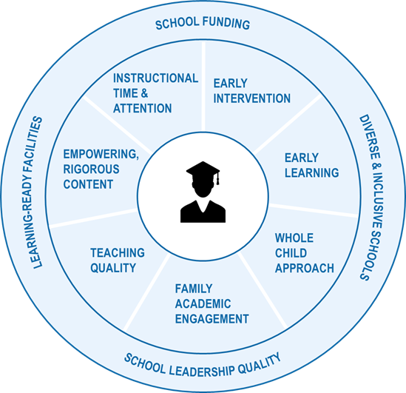
Dimensions of Resource Equity
Resource equity places student experience at the center and explores the ways in which resources are allocated and used.
The dimensions included here represent resources that school system leaders can directly control through policy or practice.
Notes:
Slide(s) should provide detailed information, such as:
This slide provides an explanation of various factors that are involved in providing education to the “whole child.”
Resource allocation should prioritize noticing the inequitable outcomes that systems produce, using improvement methods to inquire about the roots of those inequities, then acting to address the inequities through the intentional redesign of systems to meet the unique needs of all those it serves.
Helpful hints:
Emphasize that the district is concerned with the whole child and considers all dimensions of resource equity important.
The equity journey continuum provides is an informational tool to help districts view their data through the lens of equity in
order to identify gaps in students’ access to opportunities, resources, and supports.
Resource links:
Education Resource Strategies: https://www.erstrategies.org/
Equity Journey Continuum: https://www.isbe.net/equity

Slide 36
Section 4: Special Circumstances
Notes:
Helpful hints:
Be sure to “Tell Your Local Story” when presenting the information. Every district and school has a “reason why” for all aspects of the report card and financial information. Be sure this information is clearly expressed so that the audience fully understands the local context of the material.
Resource links:
Illinois Report Card: https://www.illinoisreportcard.com/
Illinois Report Card Glossary of Terms: https://www.isbe.net/Documents/2021-Report-Card-Glossary-Terms.pdf
Section Objectives
Describe recent state mandates and legislation that will have a significant impact on districts.
Describe current or planned health-life-safety and construction projects.
Describe significant or anticipated changes to enrollment information.
Discuss district consolidation, reorganizing, or redistricting boundaries.
Describe current or upcoming referendum projects in the district.
Provide the purpose of the annual financial report, location of the report, and findings.

Slide 37
State Mandates and Legislation
Notes:
Slide(s) should provide detailed information such as:
Any recent state mandates that have been recently publicized that also have a significant impact on your district and schools (e.g., financial impacts, boundary impacts, enrollment impacts).
Helpful hints:
Provide any local district context that is pertinent to the impact from state mandates. Historical context also is important to include.
Consider explaining the numerous legislative bills that were blocked by the professional Illinois associations (e.g., IASA, IASB, IASBO, IPA, IEA).
Questions to consider addressing:
Are there any state mandates or legislation that will cost our district more money?
Are there any state mandates or legislation that will impact our students?
Resource links:
Information about Illinois state senators, house representatives, and Chicago aldermen: https://www.illinoispolicy.org/maps/

Slide 38
Health-Life-Safety and Construction
Notes:
Slide(s) should provide detailed information, such as:
Any health-life-safety and construction updates that are happening or scheduled to happen in the district. Be sure to emphasize any impact this work will have on student achievement, in the short and long term, whether it has a positive impact or not.
Helpful hints:
Provide any local district context that is pertinent to construction projects. Historical context also is important to include.
Questions to consider addressing:
What educational impact will there be on our students?
How can the impacts of COVID-19 be incorporated?
Resource links:
ISBE Health and Life Safety: https://www.isbe.net/Pages/Health-and-Life-Safety.aspx

Slide 39
Enrollment Trends
Notes:
Slide(s) should provide detailed information, such as:
Any recent and significant student enrollment, student mobility, student dropout, or student graduation rate changes that are important to your setting.
Helpful hints:
Provide any local district context that is pertinent to enrollment changes. Historical context also is important to include.
Questions to consider addressing:
Why are these enrollment changes taking place?
What will the impact be on our teaching and learning?
How can the impacts of COVID-19 be incorporated?
Resource links:
Illinois Report Card: https://www.illinoisreportcard.com/

Slide 40
Consolidation, Reorganization, and Boundaries
Notes:
Slide(s) should provide detailed information, such as:
Any necessary information on the district regarding school consolidation, school district boundary changes, or building grade-level changes that have or are taking place in the communities.
Helpful hints:
Provide any local district context that is pertinent to school consolidation, boundary changes, or building grade-level changes. Historical context also is important to include.
Questions to consider addressing:
What impacts will these topics have on our students and teachers?
Why are these topics taking place in our district?
How can the impacts of COVID-19 be incorporated?
Resource links:
ISBE Consolidation At a Glance: https://www.isbe.net/Documents/consolidation.pdf
ISBE School District Reorganization At a Glance: https://www.isbe.net/Documents/Reorg.pdf

Slide 41
Referendum
Notes:
Slide(s) should provide detailed information, such as:
Any updated information regarding a local school referendum of any kind, the purpose of the referendum, the timing, the status, etc.
Helpful hints:
Provide any local district context that is pertinent to a referendum. Historical context also is important to include.
Questions to consider addressing:
What impacts will this referendum have on our district if passed?
What impacts will this referendum have on our district if not passed?

Slide 42
Annual Financial Report/Audit
Notes:
Slide(s) should provide detailed information, such as:
Information on the most recent audit report that is conducted each year. This could just be a link to where the annual financial report is located online or on your own website, or you may wish to go into further detail here depending on the district’s history of discussing this topic.
Questions to consider addressing:
What are the significant findings from the annual audit?
Resource links:
ISBE Archive Publications/Reports: https://www.isbe.net/Pages/School-Finance-Historical-Reports.aspx

Slide 43
Section 5: Closing
Notes:
Helpful hints:
Be sure to “Tell Your Local Story” when presenting the information. Every district and school has a “reason why” for all aspects of the report card and financial information. Be sure this information is clearly expressed so that the audience fully understands the local context of the material.
Resource links:
Illinois Report Card: https://www.illinoisreportcard.com/
Illinois Report Card Glossary of Terms: https://www.isbe.net/Documents/2021-Report-Card-Glossary-Terms.pdf
Section Objectives
Discuss opportunities for growth that the district is planning.
Discuss opportunities for the audience to provide input and feedback to the district.
Discuss the frequently asked questions document available on the website.

Slide 44
Opportunities for Growth
Notes:
Slide(s) should provide detailed information, such as:
Summarize the opportunities for growth that the district is currently facing. Now that the audience is more aware of the academic and financial status of the district and school, and has learned more about the school report card, clarify the goals that the district and school have identified to improve. Or clarify the process the district will use to identify the goals.

Slide 45
Input/Feedback
Notes:
Slide(s) should provide detailed information, such as:
Describe how audience members can provide feedback to the superintendent and/or school board regarding future financial topics they would like to hear more about or how they can provide general feedback to district leaders for future decision making.
Helpful hints:
Consider providing multiple opportunities for the school community to offer feedback to the school leadership.
Consider providing multiple opportunities for the staff and community to offer feedback on culture/climate and working conditions.
Consider using resources like Google Forms or Google Jamboard, or create an exit ticket activity.

Slide 46
Disclaimer
This material is in the public domain. While permission to reprint is not necessary, publication should be cited. This material is prepared by the Region 9 Comprehensive Center under Award #S283B190010 for the Office of Program and Grantee Support Services (PGSS) within the Office of Elementary and Secondary Education (OESE) of the U.S. Department of Education and is administered by the American Institutes for Research®. The content of the presentation does not necessarily reflect the views or policies of the PGSS or OESE or the U.S. Department of Education nor does mention of trade names, commercial products, or organizations imply endorsement by the U.S. Government.
Notice of Trademark: “American Institutes for Research” and “AIR” are registered trademarks. All other brand, product, or company names are trademarks or registered trademarks of their respective owners.
19486_10/22

Slide 47
Frequently Asked Questions (FAQs)
Notes:
Slide(s) should provide detailed information, such as:
Include new terms, phrases, or acronyms that might have popped up in recent years.
Provide the location of the FAQ document that is on your website.
Helpful hints:
Reiterate that there is not sufficient time in these types of presentations to provide all the information that you would like to provide; therefore, the FAQ document is available with links to more readily available information from trusted sources, such as ISBE, the Illinois Association of School Business Officials, the Illinois Association of School Boards, and others.

